Slide 1
A core Course on Modeling
Introduction to Modeling
0LAB0 0LBB0 0LCB0 0LDB0
c.w.a.m.v.overveld@tue.nl
v.a.j.borghuis@tue.nl
S.17

Slide 2
Formalization phase: making formulas
define
formulate
purpose
conceptualize
identify
entities
choose
relations
formalize
obtain
values
formalize
relations
execute
operate
model
obtain
result
conclude
present
result
interpret
result
Notes:
2

Slide 3
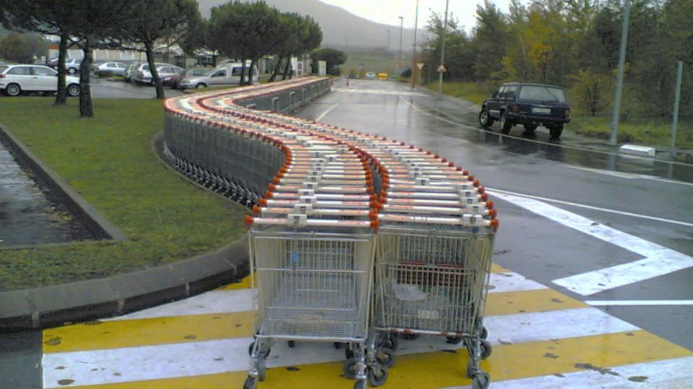
What is the meaning of + ?
increase, abundance, completion, assembly, ...
http://www.sxc.hu/browse.phtml?f=download&id=423104
Notes:
3

Slide 4
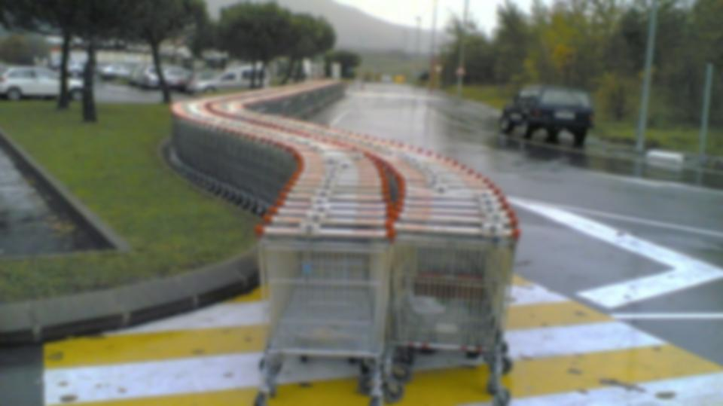
What is the meaning of + ?
increase, abundance, completion, assembly, ...
the intuition of ‘addition’, ‘accumulation’:
http://www.sxc.hu/browse.phtml?f=download&id=423104
resistors: R_{tot} = R₁ + R₂
resistors: R_{tot} = 1/(1/R₁ + 1/R₂)
springs: C_{tot} = 1/(1/C₁+1/C₂)
springs: C_{tot} = C₁ + C₂
Notes:
4

Slide 5
What is the meaning of + ?
increase, abundance, completion, assembly, ...
the intuition of ‘addition’, ‘accumulation’:
http://www.sxc.hu/browse.phtml?f=download&id=423104
An interpretation is required when going from
relations in ‘real world’ to mathematical relations.
No generic way to do so.
We need a (heuristic) process.
Notes:
5

Slide 6
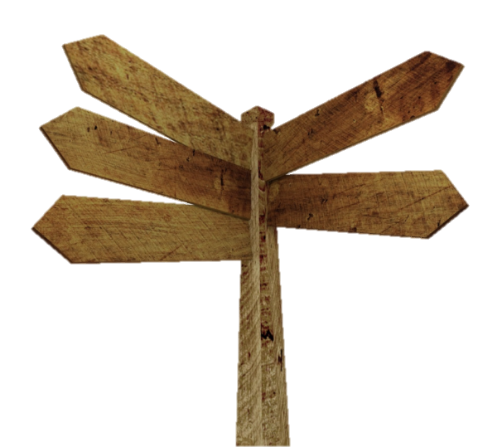
Heuristics for formal expressions:
meaningful names
chain of dependencies
todo-list
dimensional analysis
wisdom of the crowds
http://www.sxc.hu/photo/1175080
Notes:
6

Slide 7
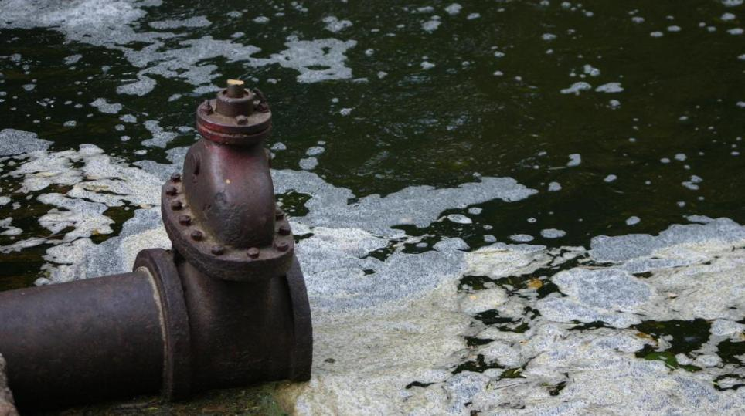
Example:
“What is the total amount of detergent
annually dumped in the
environment in the Netherlands?”
http://www.sxc.hu/browse.phtml?f=download&id=335512
Notes:
7

Slide 8
Example:
“What is the total amount of detergent
annually dumped in the
environment in the Netherlands?”
http://www.sxc.hu/browse.phtml?f=download&id=335512
QUIZ
How do you find out the total amount of detergent annually dumped in the environment in the Netherlands?
Notes:
8

Slide 9
relations
dimensions
assumptions
todo
amAnDetDmp =
f(nrAnWshs , detPWsh)
[kg / year] =
F([wash / year] , [kg / wash])
amAnDetDmp
nrAnWshs
detPWsh
Det:detergent; An: annual; Wsh: wash; Fam: family; P: people; am: amount; Dmp: dump
Notes:
9
This type of model is a ‘thumbnail calculation’:
OK for quick order of magnitude estimations
Uses straightforward substitutions, only based on dimension analysis
Work with intervals to get an impression of the variation of the answers (143 ± 67 M; correct value according to various sites such as http://wiki.watmooi.nl/pages/Wassen_en_onderhoud is 150 M kg)
Purpose: pub quizzes, trivial pursuit, …

Slide 10
relations
dimensions
assumptions
todo
amAnDetDmp =
nrAnWshs * detPWsh
[kg / year] =
[wash / year] * [kg / wash]
amAnDetDmp
nrAnWshs
detPWsh
Det:detergent; An: annual; Wsh: wash; Fam: family; P: people; am: amount; Dmp: dump
Notes:
10
This type of model is a ‘thumbnail calculation’:
OK for quick order of magnitude estimations
Uses straightforward substitutions, only based on dimension analysis
Work with intervals to get an impression of the variation of the answers (143 ± 67 M; correct value according to various sites such as http://wiki.watmooi.nl/pages/Wassen_en_onderhoud is 150 M kg)
Purpose: pub quizzes, trivial pursuit, …

Slide 11
http://www.sxc.hu/photo/1072657
relations
dimensions
assumptions
todo
amAnDetDmp =
nrAnWshs * detPWsh
[kg / year] =
[wash / year] * [kg / wash]
Washing laundry is the only way detergent gets into the environment
amAnDetDmp
nrAnWshs
detPWsh
nrAnWshsPFam
nrFamIH
nrPIH
nrPPFam
nrAnWshs =
nrAnWshsPFam * nrFamIH
[wash / year] =
[wash / (fam *year)] * [fam]
No institutional laundry washing, only families
nrFamIH =
nrPIH / nrPPFam
[fam] =
[people] / [people / fam]
Everybody belongs to exactly one family: families are disjoint
nrPIH = 17 ± 0.5 million [people]
common knowledge
nrPPFam = 2.2 ± 0.2 [people/fam]
public domain
nrAnWshsPFam = 100 ± 20 [wash / year]
Det:detergent; An: annual; Wsh: wash; Fam: family; P: people; am: amount; Dmp: dump
Notes:
11

Slide 12
http://www.sxc.hu/photo/1072657
relations
dimensions
assumptions
todo
amAnDetDmp =
nrAnWshs * detPWsh
[kg / year] =
[wash / year] * [kg / wash]
Washing laundry is the only way detergent gets into the environment
amAnDetDmp
nrAnWshs
detPWsh
nrAnWshsPFam
nrFamIH
nrPIH
nrPPFam
nrAnWshs =
nrAnWshsPFam * nrFamIH
[wash / year] =
[wash / (fam *year)] * [fam]
No institutional laundry washing, only families
nrFamIH =
nrPIH / nrPPFam
[fam] =
[people] / [people / fam]
Everybody belongs to exactly one family: families are disjoint
nrPIH = 17 ± 0.5 million [people]
common knowledge
nrPPFam = 2.2 ± 0.2 [people/fam]
public domain
nrAnWshsPFam = 100 ± 20 [wash / year]
wisdom of the crowds
todo list is empty → model is ready
detPWsh = 0.17 ± 0.03 [kg / wash]
wisdom of the crowds
Det:detergent; An: annual; Wsh: wash; Fam: family; P: people; am: amount; Dmp: dump
Notes:
12

Slide 13
This approach yields expressions forming a tree:
http://www.sxc.hu/photo/1006441
amAnDetDmp
1.31±… million
*
amAnDetDmp
nrAnWshs
detPWsh
nrAnWshsPFam
nrFamIH
nrPIH
nrPPFam
detPWsh
*
nrAnWshs
0.17±0.03
772±…million
/
nrFamIH
7.72± … million
nrAnWshsPFam
100±20
nrPIH
nrPPFam
17±0.5 million
2.2±0.2
Det:detergent; An: annual; Wsh: wash; Fam: family; P: people; am: amount; Dmp: dump
Notes:
13

Slide 14
This type of model is a ‘thumbnail calculation’
OK for quick order of magnitude estimations
based on dimension analysis.
Use intervals to estimate variation of the answers.
(143 ± 67 M; correct value ≅150 M kg)
http://www.sxc.hu/browse.phtml?f=download&id=114488
Notes:
14

Slide 15
This type of model is a ‘thumbnail calculation’
OK for quick order of magnitude estimations
based on dimension analysis.
Use intervals to estimate variation of the answers.
(143 ± 67 M; correct value ≅150 M kg)
QUIZ
How did we obtain the margin in the answer?
http://www.sxc.hu/browse.phtml?f=download&id=114488
Notes:
15

Slide 16
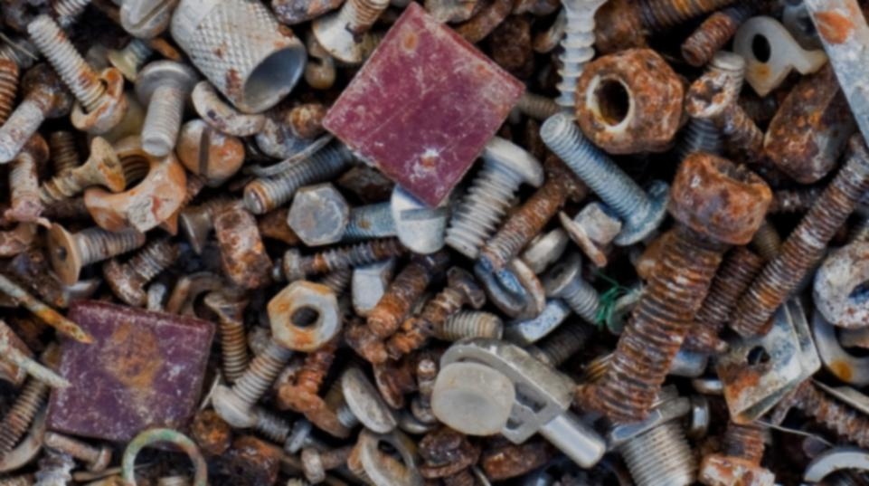
From conceptual model to formal model:
while your purpose is not satisfied:
start with quantity you need for the purpose
put this on the to-do list
while the todo list is not empty:
take a quantity from the todo list
think: what does it depend on?
if depends on nothing
substitute constant value
else
give an expression
if possible, use dimensional analysis
propose suitable mathematical expression
think about assumptions
verify dimensions
add newly introduced quantities to the todo list
todo list is empty: evaluate your model
as long as purpose is not satisfied: repeat
http://www.sxc.hu/browse.phtml?f=download&id=941007
Notes:
16

